Slide 1

An Analysis On
MSCA 31012 | Data Engineering Platforms | Group 4
12 June 2020

Slide 2


MEET OUR TEAM - FANFLIX
Nouf AlZamel
Faryal Masood
Abhiniti Mahendrakar
Data Engineer
Data Architect
Business Analyst

Slide 3
AGENDA
1
Project Overview
5
Data Visualization
2
Data Collection
6
NoSQL Databases
3
Data Exploration
7
Conclusions
4
Data Storage
8
Recommendations

Slide 4
PROJECT OVERVIEW

Slide 5
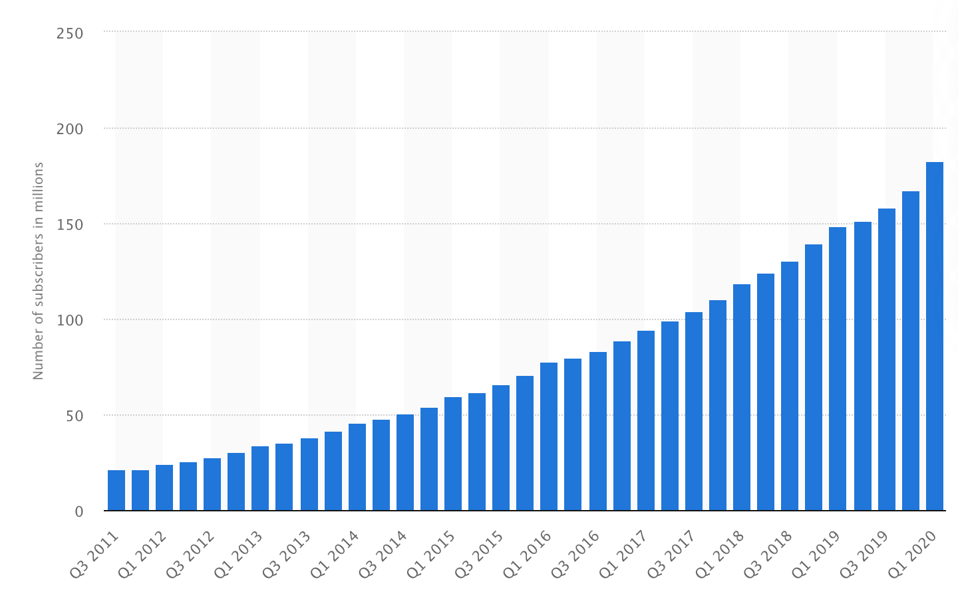
EXECUTIVE SUMMARY
Housing a combination of in-house and existing content, Netflix is one of the largest streaming services that currently exists.
Their streaming service extends to 183 million subscribers in over 190 countries.
The graph shows the increasing demand of their streaming services.
We gathered shows data hosted on Netflix and their associated reviews from sources for analyzing the potential in streaming industry.
With analysis and data visualization, we were able to get initial insights to make a potential business decision
Netflix Subscribers from 2011 Q3 to 2020 Q1
https://www.statista.com/statistics/250934/quarterly-number-of-netflix-streaming-subscribers-worldwide/

Slide 6





BUSINESS USE CASE
As streaming services are taking over the entertainment industry over cable, we are a potential company wanting to enter the streaming industry.
Understand the variety of series/movies offered by Netflix
Distinguish all the locations Netflix offers its services
Identify the trends in seasonality within the data
Analyze the success metric of all shows (IMDb vs Rotten Tomatoes)
Determine our target audience of streaming movies and shows

Slide 7






DATA TOOLS AND PIPELINE
Conversion to JSON
CSV
API
Web scraping
DATA SOURCES
DATA COLLECTION
DATA CLEANING
DATA STORAGE
DATA ANALYSIS & VISUALIZATION

Slide 8
DATA COLLECTION

Slide 9
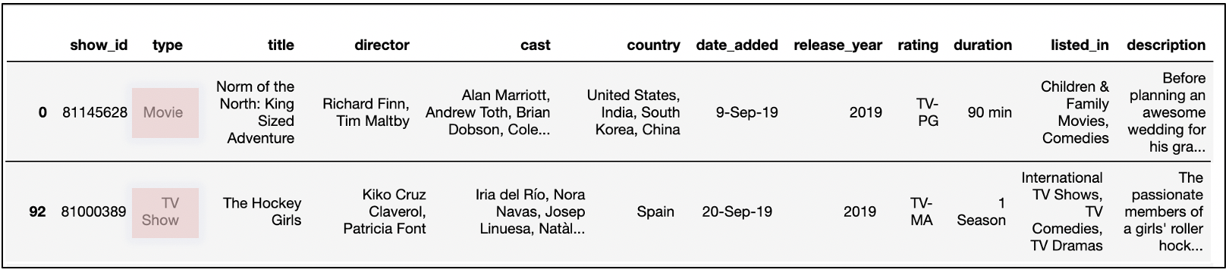
NETFLIX CSV
Raw CSV File
Type: can be movie or TV Show
Cast and director: contains a list of each respectively
Country: Shows the countries where Netflix is streaming a show
Date_added: The date a show was added to Netflix

Slide 10


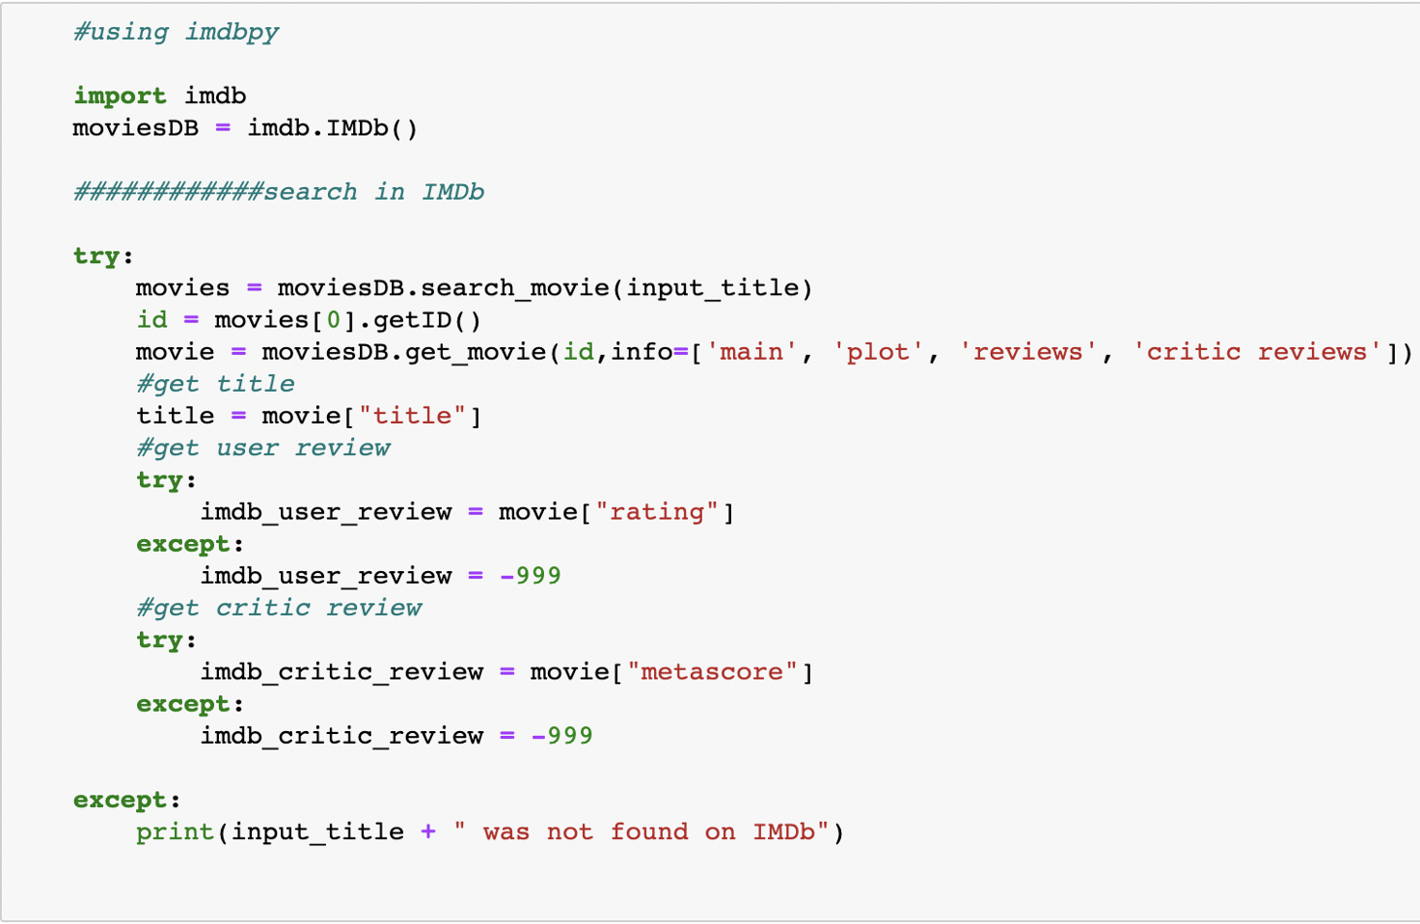
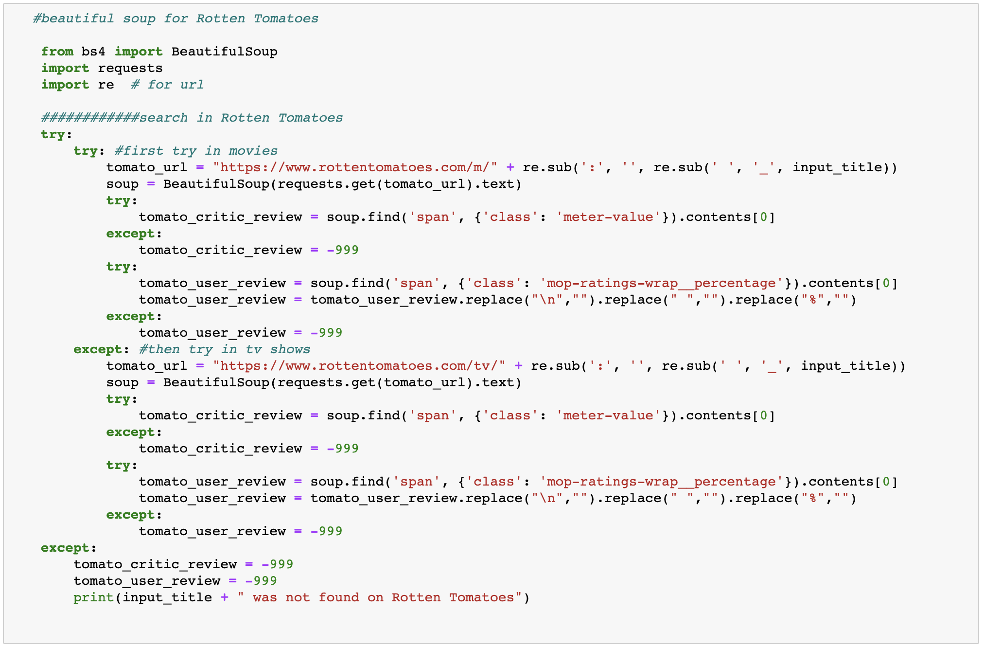
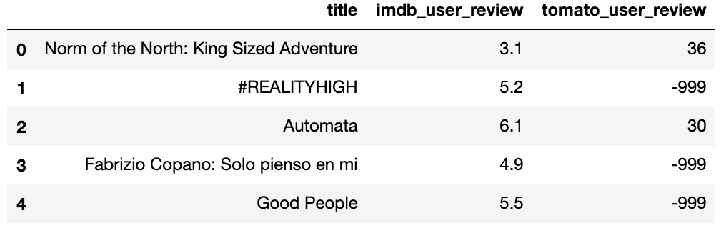
WEB SCRAPING
IMDbPY
A python package to search and retrieve information about movies from the IMDb API
Beautiful Soup
A python package to parse HTML documents
Output data
Notes:
As Netflix was the first and currently the largest streaming service, we have chosen to analyze their current inventory of movies and tv shows, taken from Flixable
As we do not have any response variables from Netflix other than the duration of TV show or a movie, we web scraped user review data from IMDb (using IMDbPY) and Rotten Tomatoes (using Beautiful Soup)

Slide 11
DATA EXPLORATION

Slide 12
DATA PROFILE
Data Source
Dataset | Netflix | IMDb rating | Rotten Tomatoes rating
Method | CSV | API | Web Scraping
Type of Data | Structured | Structured | Structured
Total Rows | 6,172 | 3,778
Total Columns | 12 | 3
Data Size | 2.3 MB | 143 KB
URL | Click Here | Click Here | Click Here

Slide 13
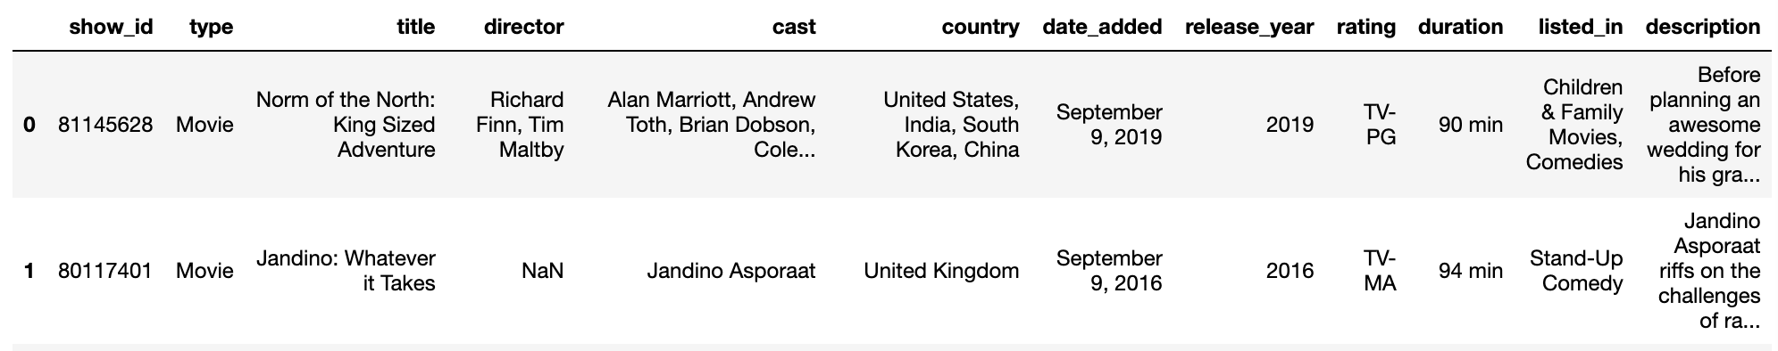

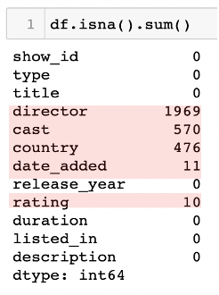
DATA ANOMALIES AND PREPARATION
Netflix
dataset
Netflix data
Reviews data
Notes:
Missing values: Delete rows with null values
Missing values: identify null reviews and replace it with an easily identifiable number

Slide 14
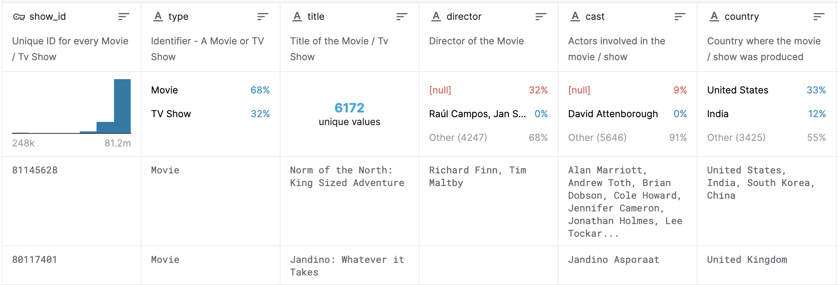
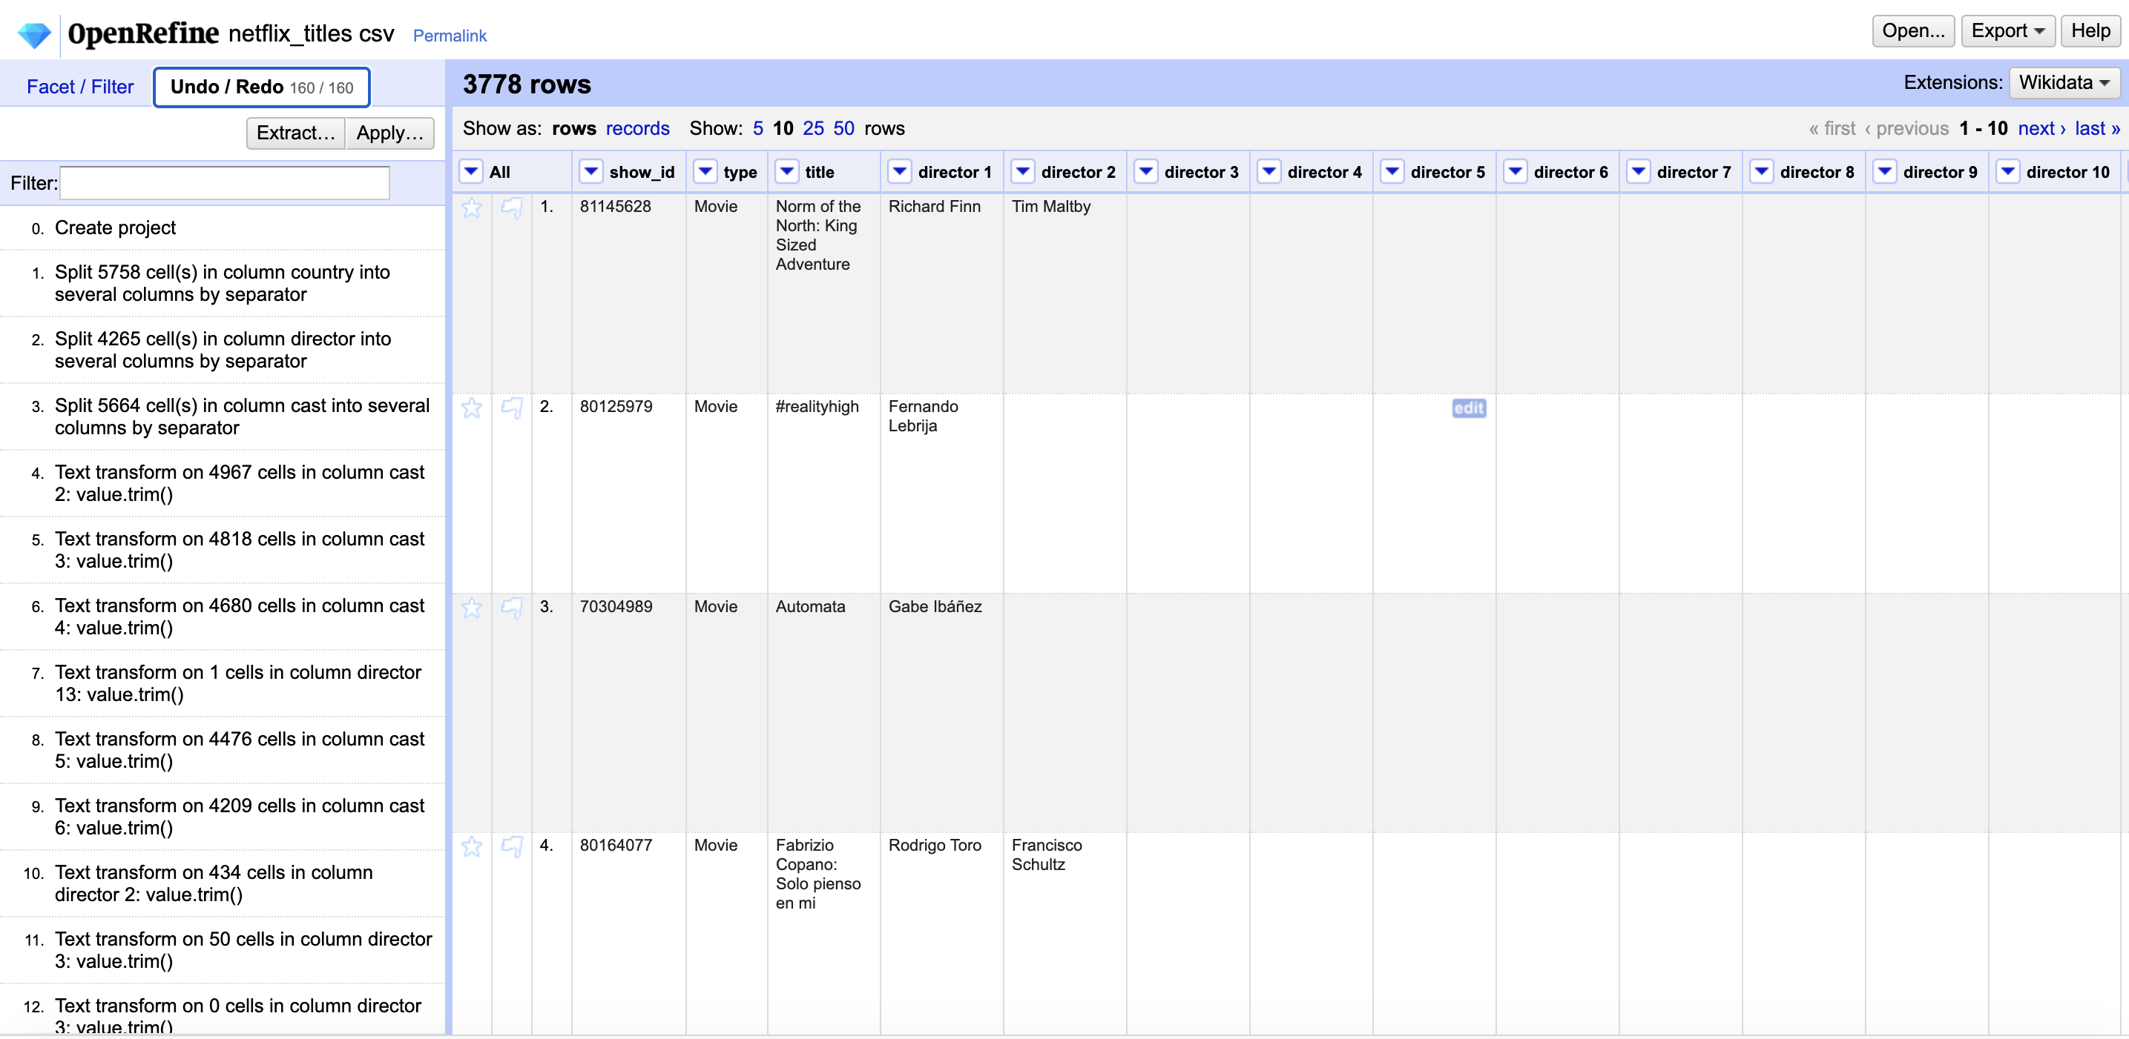
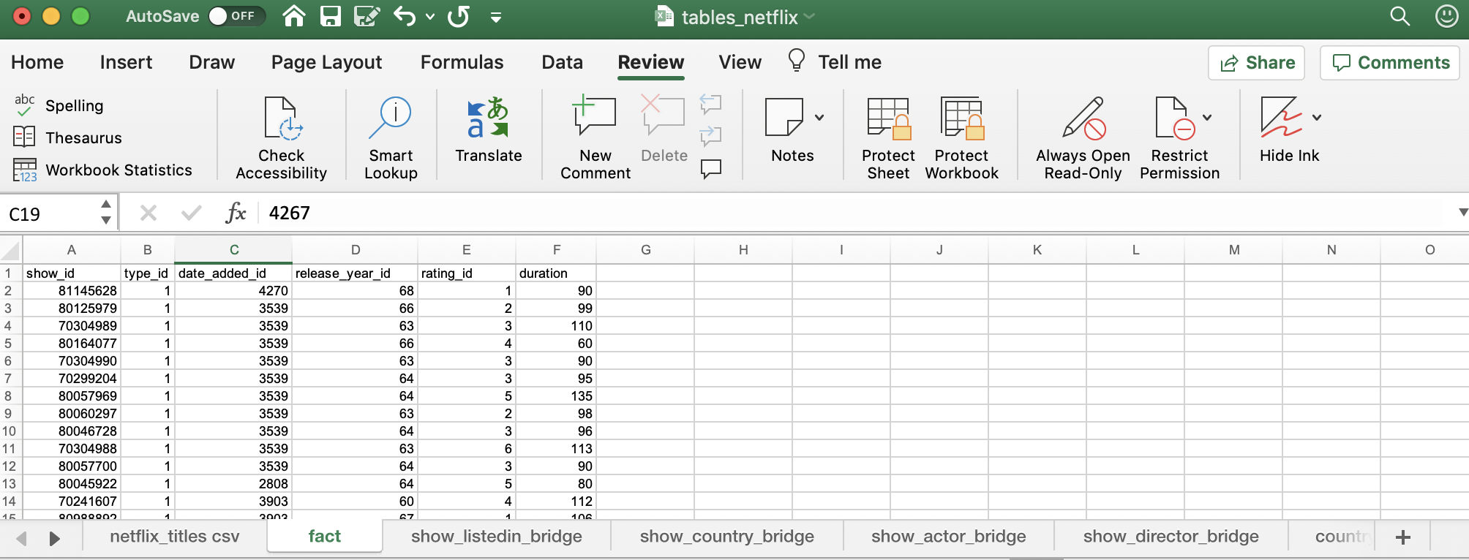
NORMALIZATION
Not in 1NF – Some columns consist of non-atomic data
Data Cleaning and Normalization in Open Refine and MS Excel

Slide 15
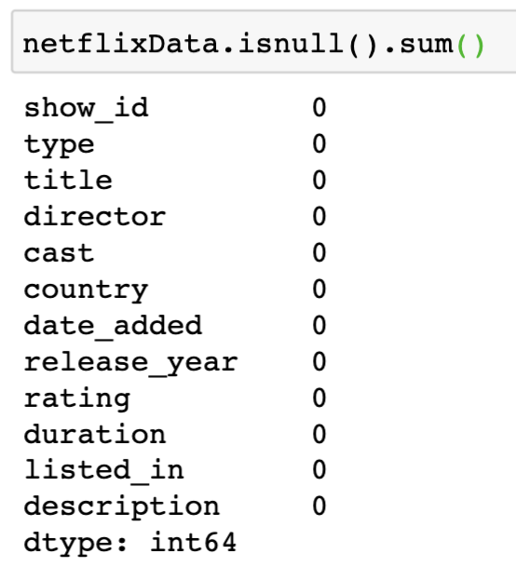
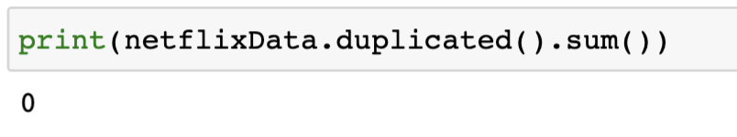
DATA QUALITY METRICS
1: Completeness
2: Uniqueness
3: Consistency
Our data values have been cleaned to ensure not having missing elements
Our dataset does not have any duplicate data
No inconsistencies found
4: Validity
All dates are valid. No occurrence of Feb, 30
5: Accuracy
6: Timeliness
Some of the movies had incomplete list of cast names
The movies dataset is updated monthly, and ratings can be accessed anytime
Notes:
Accuracy
Completeness
Consistency
Timeliness
Validity
Uniqueness

Slide 16
DATABASE MODELING AND STORAGE

Slide 17
DESIGN CONSIDERATIONS
All tables were normalized and had a single primary key
There were constraints on the primary and foreign keys that they could not be NULL
Naming Convention: All dimension tables start with dim and fact tables start with fact to easily identify
Creating bridge tables to map Many to Many relationship
Database was password protected for privacy purposes
We chose MySQL and Google Cloud Platform
Easily accessible
User-friendly
Easily integrated with Tableau

Slide 18
DIMENSIONAL MODEL
Notes:
Our facts are related to our shows, so we merged the fact table and the show table. That’s why our fact table contains two text fields

Slide 19
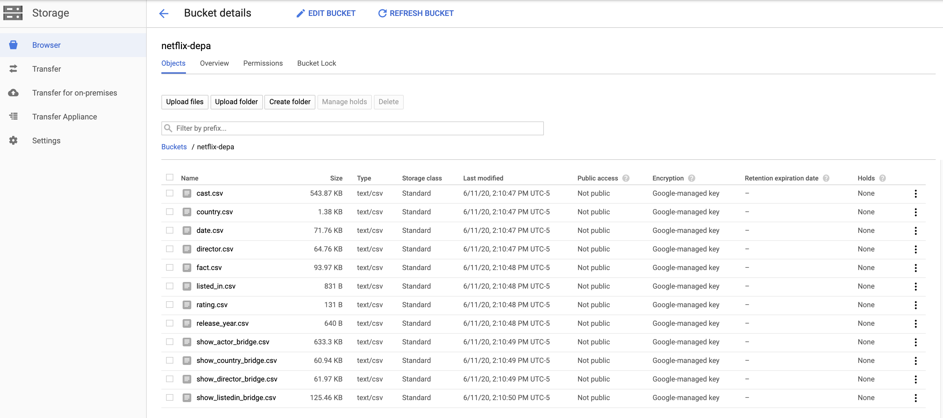
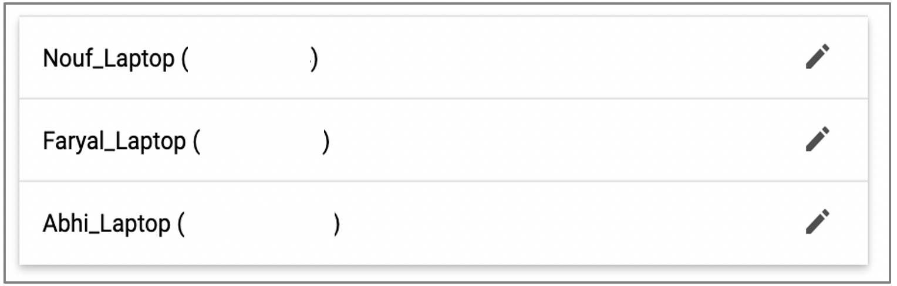

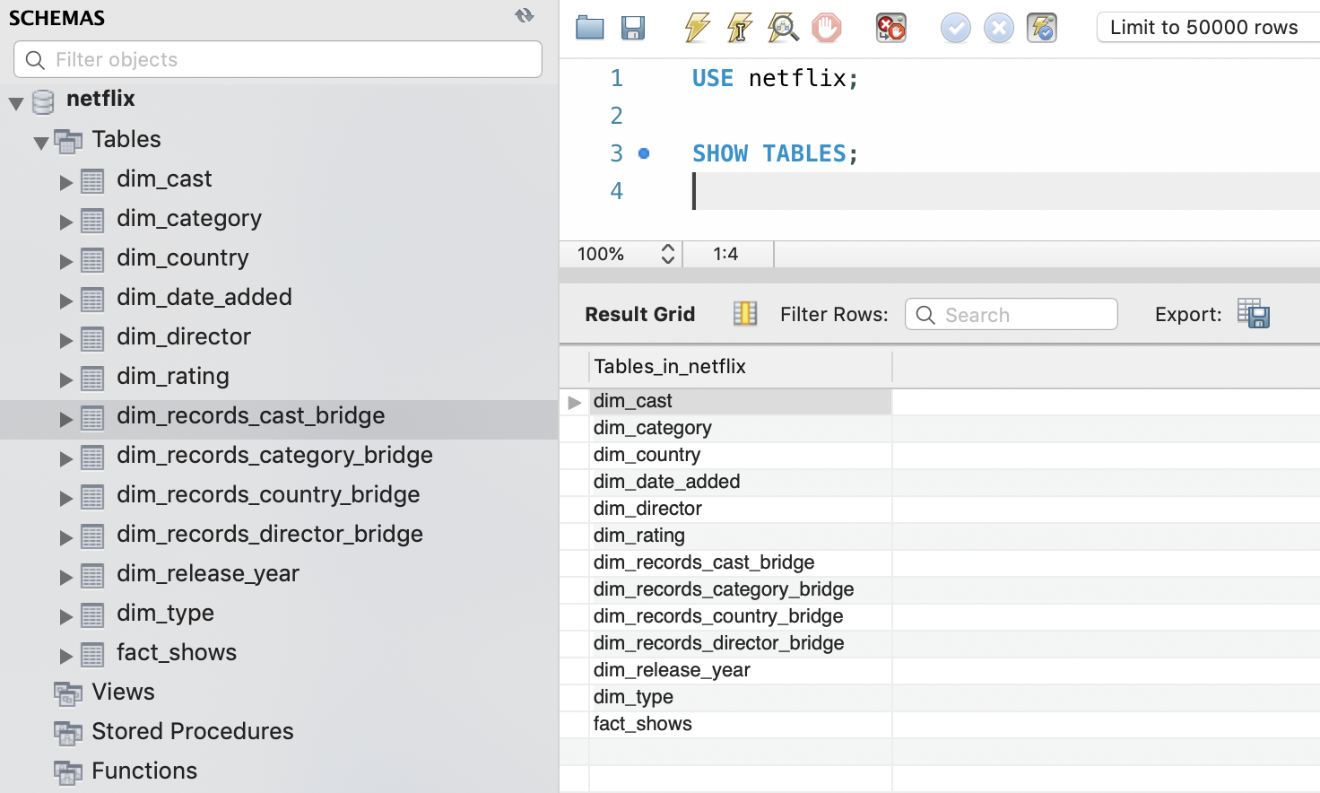
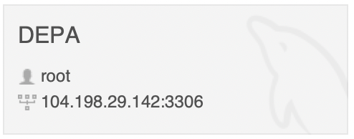
DATA LOADING IN GCP AND MYSQL
Instance ID: 104.198.29.142
User: root
Password: rootroot

Slide 20
DATA VISUALIZATION

Slide 21
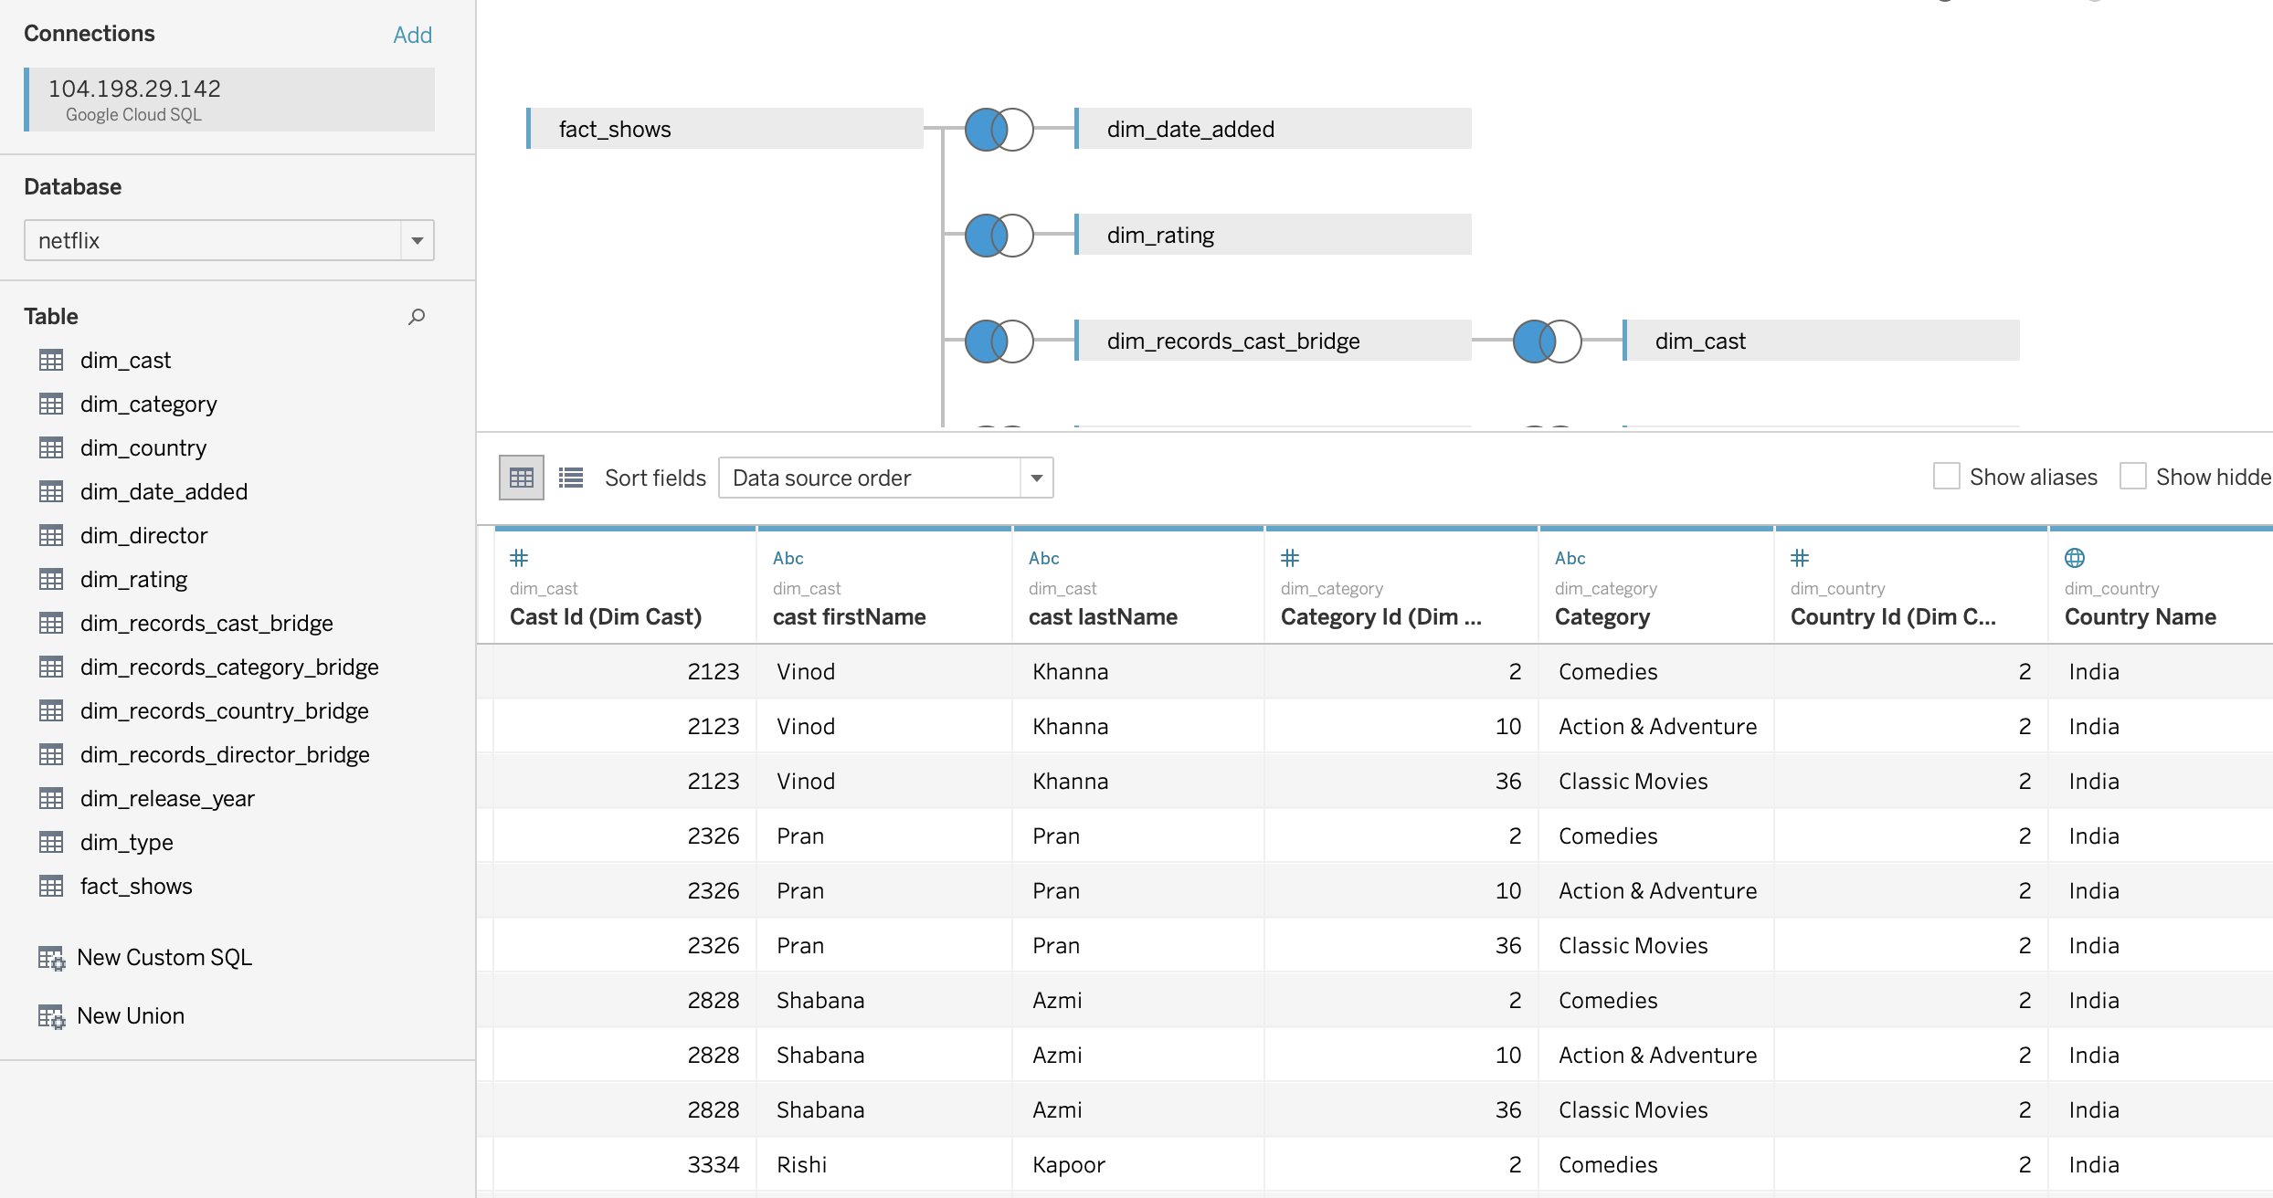
TABLEAU INSIGHTS
Our Tableau notebook connects directly to the GCP instance

Slide 22
ANALYTICAL FINDINGS
NETFLIX | OUR ACTION
Most of Netflix’s shows are international | Our focus will be viewership in the United States
Dramas and comedies make up the largest percentage of shows accessible to US Netflix | Want to focus on the categories not commonly found on Netflix
Netflix generally releases shows in Q1 + Q4, January + November, and on Fridays | Add shows at off-season timings, alongside a strong marketing campaign to bolster enthusiasm
Response metrics gathered by Netflix’s own viewers | Take the IMDb and Rotten Tomatoes reviews as a base of success for Netflix’s inventory, keeping their trends in mind

Slide 23
NOSQL DATABASES

Slide 24
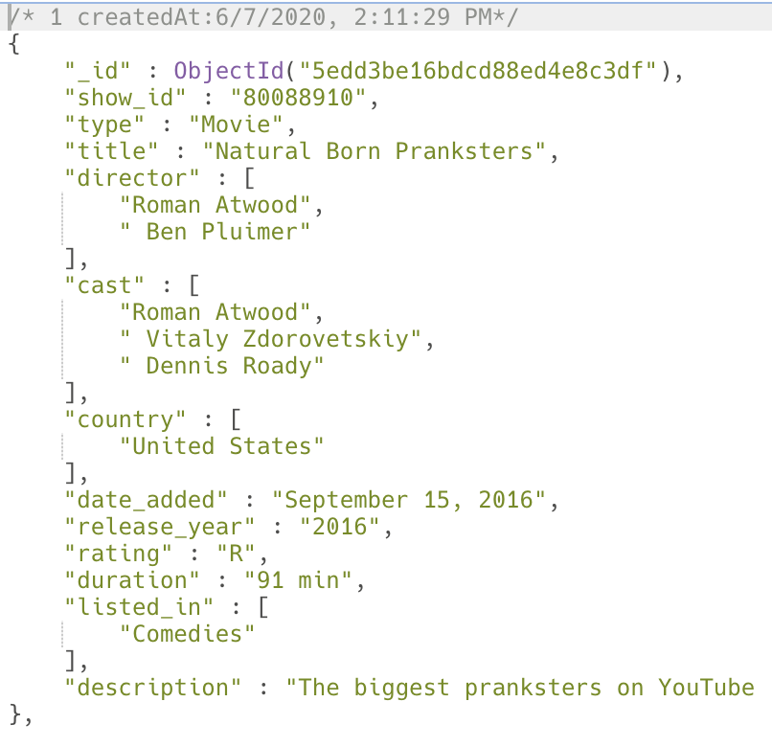
NOSQL DATABASE ( MongoDB )
The original format of Netflix Kaggle data, IMDB, and rotten tomatoes datasets were in csv.
we had to process the data to fit into the requirements of MongoDB
JSON model
Collection1:
director.json
Each show is a document within our ‘showRecords’ collection with each document having several fields
Collection2:
cast.json
Collection3:
fields within a document where a Many to Many relationship exists have been dealt with by creating a new collection and referencing them with their id.
showRecords.json
Original JSON file generated from our datasets “ Denormalized ”

Slide 25
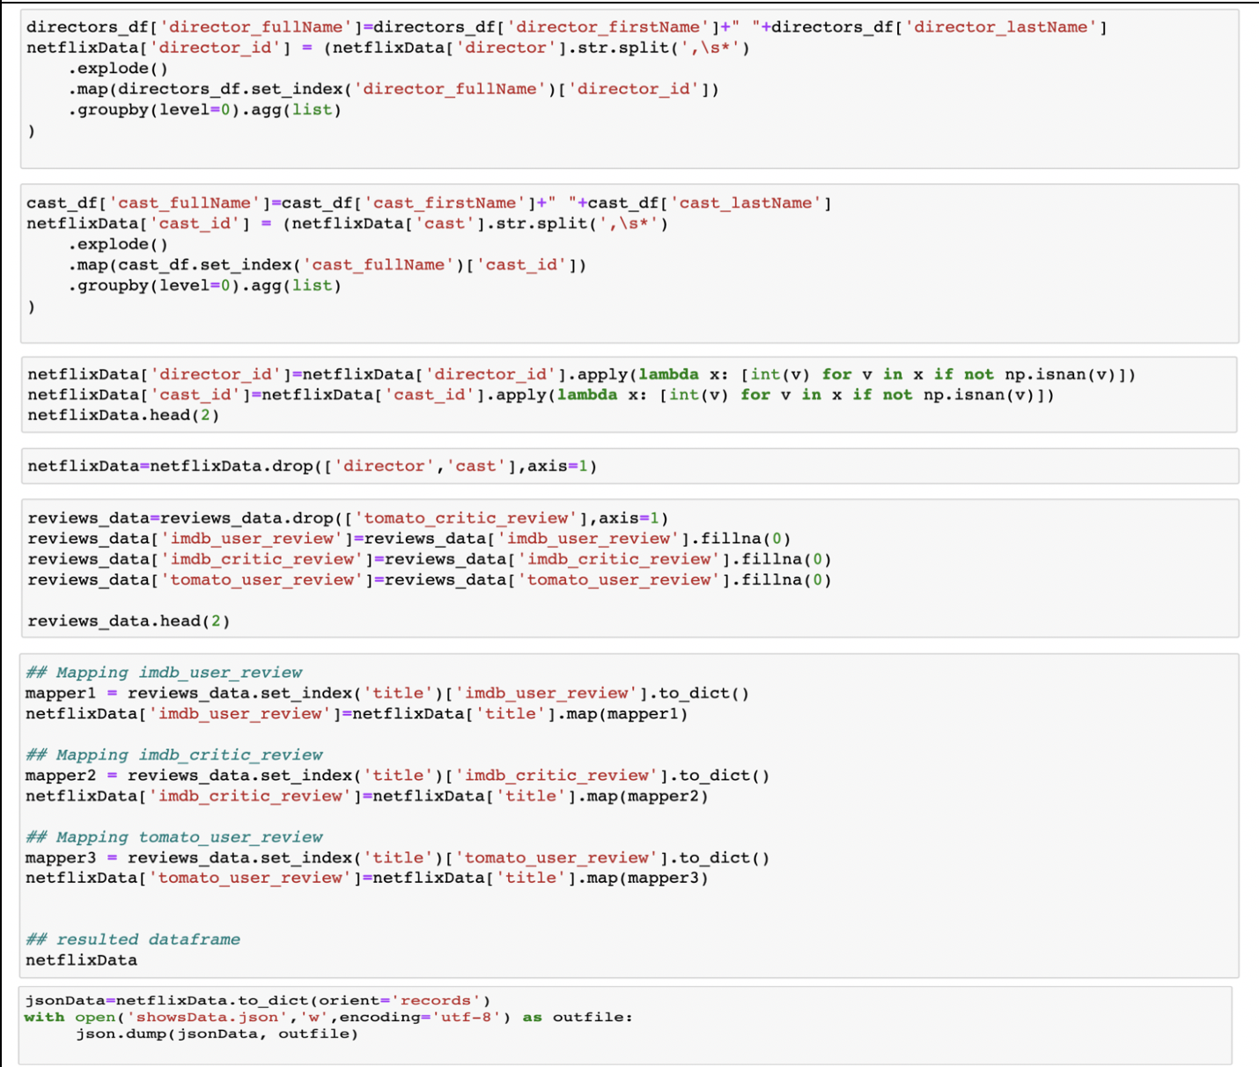
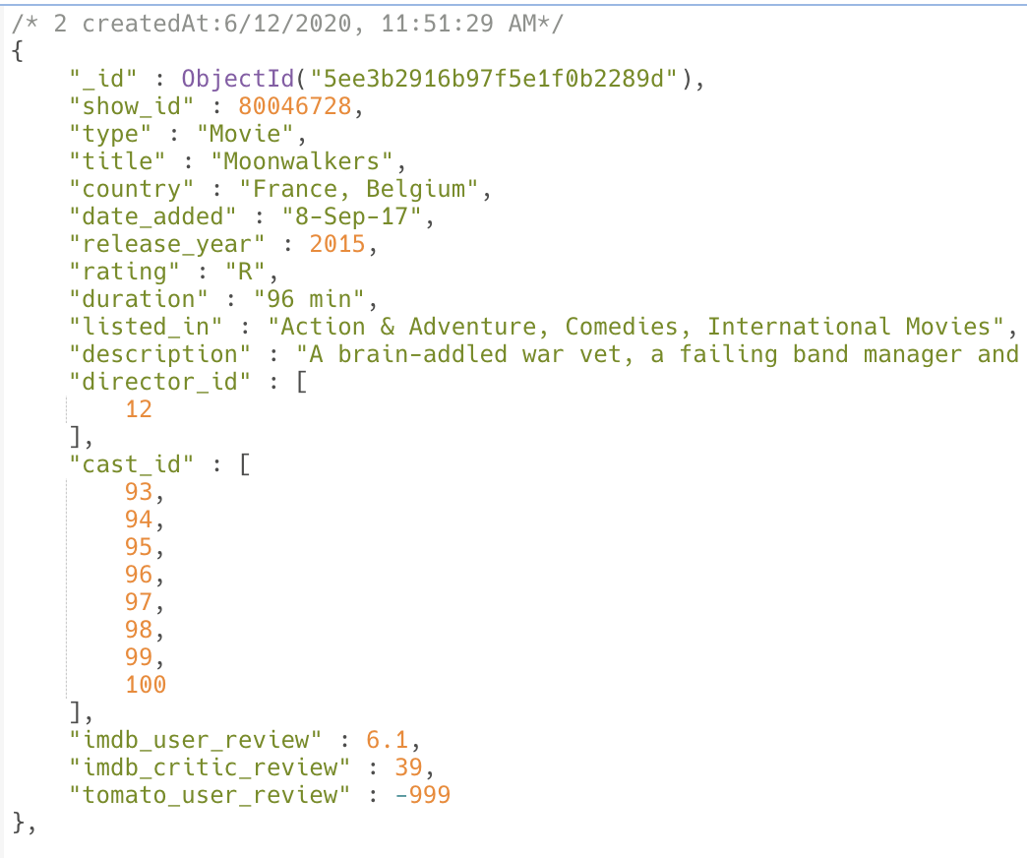
NOSQL DATABASE ( MongoDB )
Using python, we created a json file for the desired json model
Resulted JSON file

Slide 26
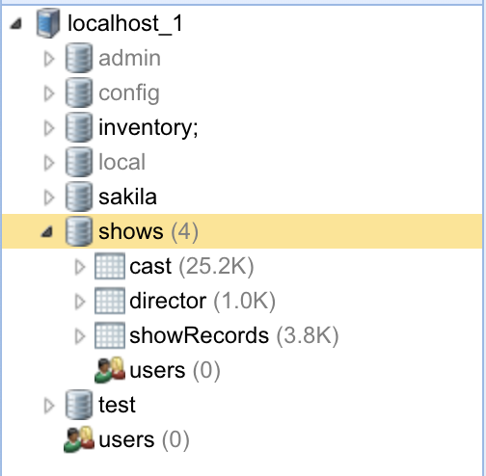
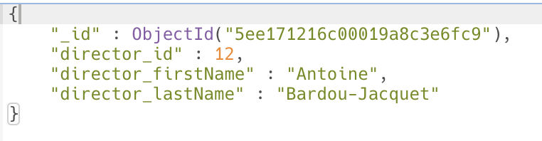
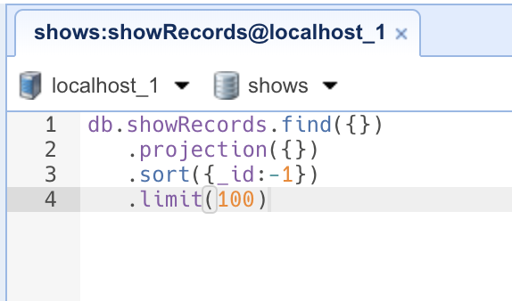
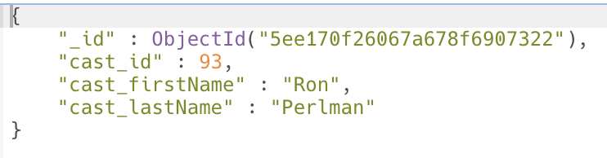
NOSQL DATABASE ( MongoDB )
Imported data into MongoDB
Resulted JSON files
showRecords.json
director.json
cast.json

Slide 27
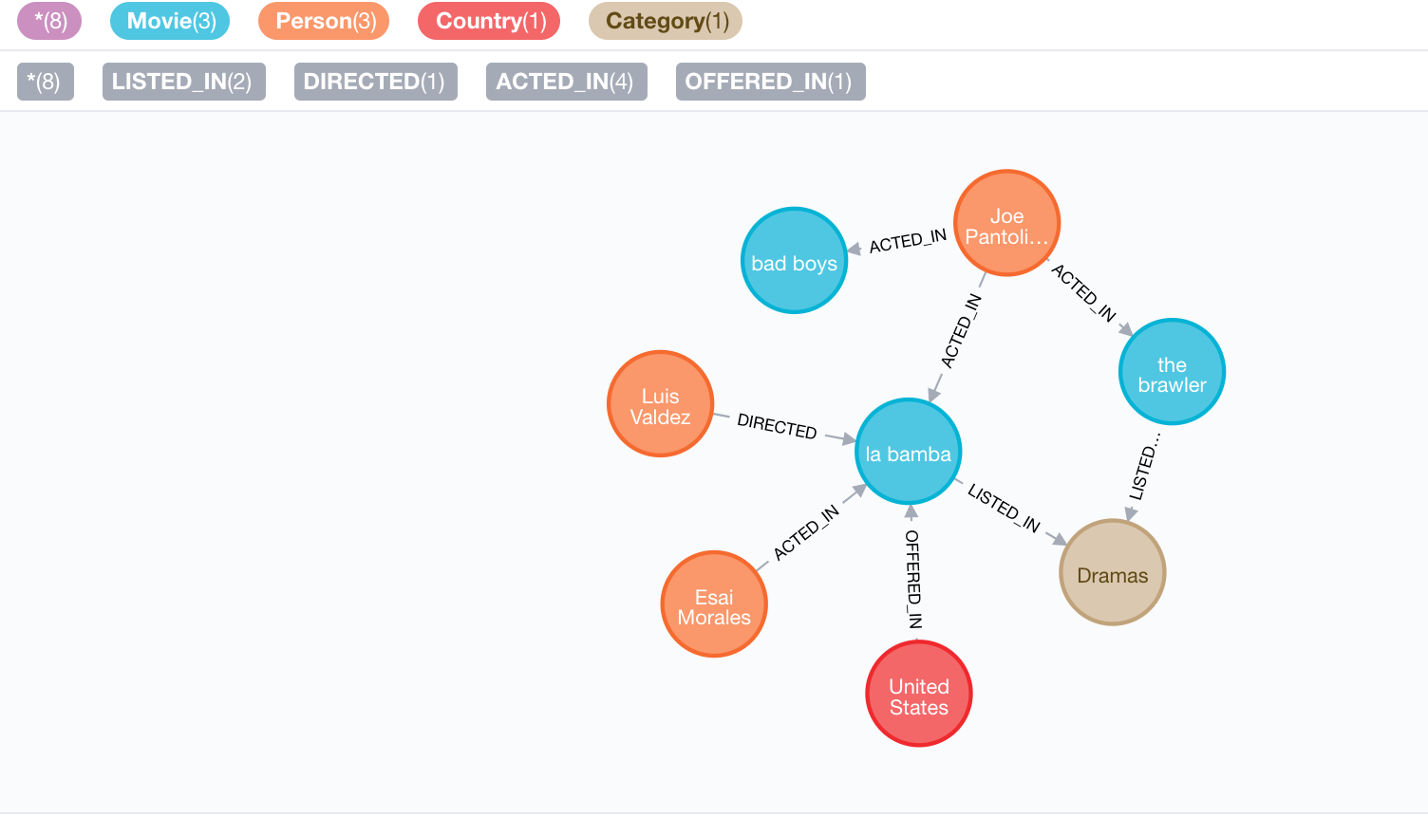
NOSQL DATABASE ( NEO4J )
NODE LABELS
MOVIE, PERSON, COUNTRY, CATEGORY
RELATIONSHIP TYPES
PERSON – [:ACTED_IN] -> MOVIE
PERSON – [:DIRECTED] -> MOVIE
MOVIE – [:LISTED_IN] -> CATEGORY
MOVIE – [:OFFERED_IN] -> COUNTRY
PROPERTY KEYS
MOVIE
title, description, type, date_added, release_year, rating, duration, imdb_review, rt_review
PERSON
name
CATEGORY
categoryName
COUNTRY
countryName

Slide 28
RECOMMENDATIONS

Slide 29

CORRECTIVE MEASURES AND SCOPE FOR IMPROVEMENT
Gather data from other large streaming networks
Identify other metrics that might help in the organizational success and analyze them
Storing historical data

Slide 30
LESSONS LEARNED
To Keep business objective in mind while searching for data
Data Exploration – Know your data
Data Cleaning is a lengthy process and might be repeated several times.

Slide 31
REFERENCES
https://www.kaggle.com/shivamb/netflix-shows/data
https://developer.imdb.com/
https://www.rottentomatoes.com/
https://stackoverflow.com/questions/580233/what-are-the-most-important-considerations-when-designing-a-database
https://stackoverflow.com/questions/19697846/how-to-convert-csv-file-to-multiline-json
https://www.youtube.com/watch?v=Uze9SEeETA0
DEPA Class Notes

Slide 32
QUESTIONS

Slide 33
APPENDIX

Slide 34
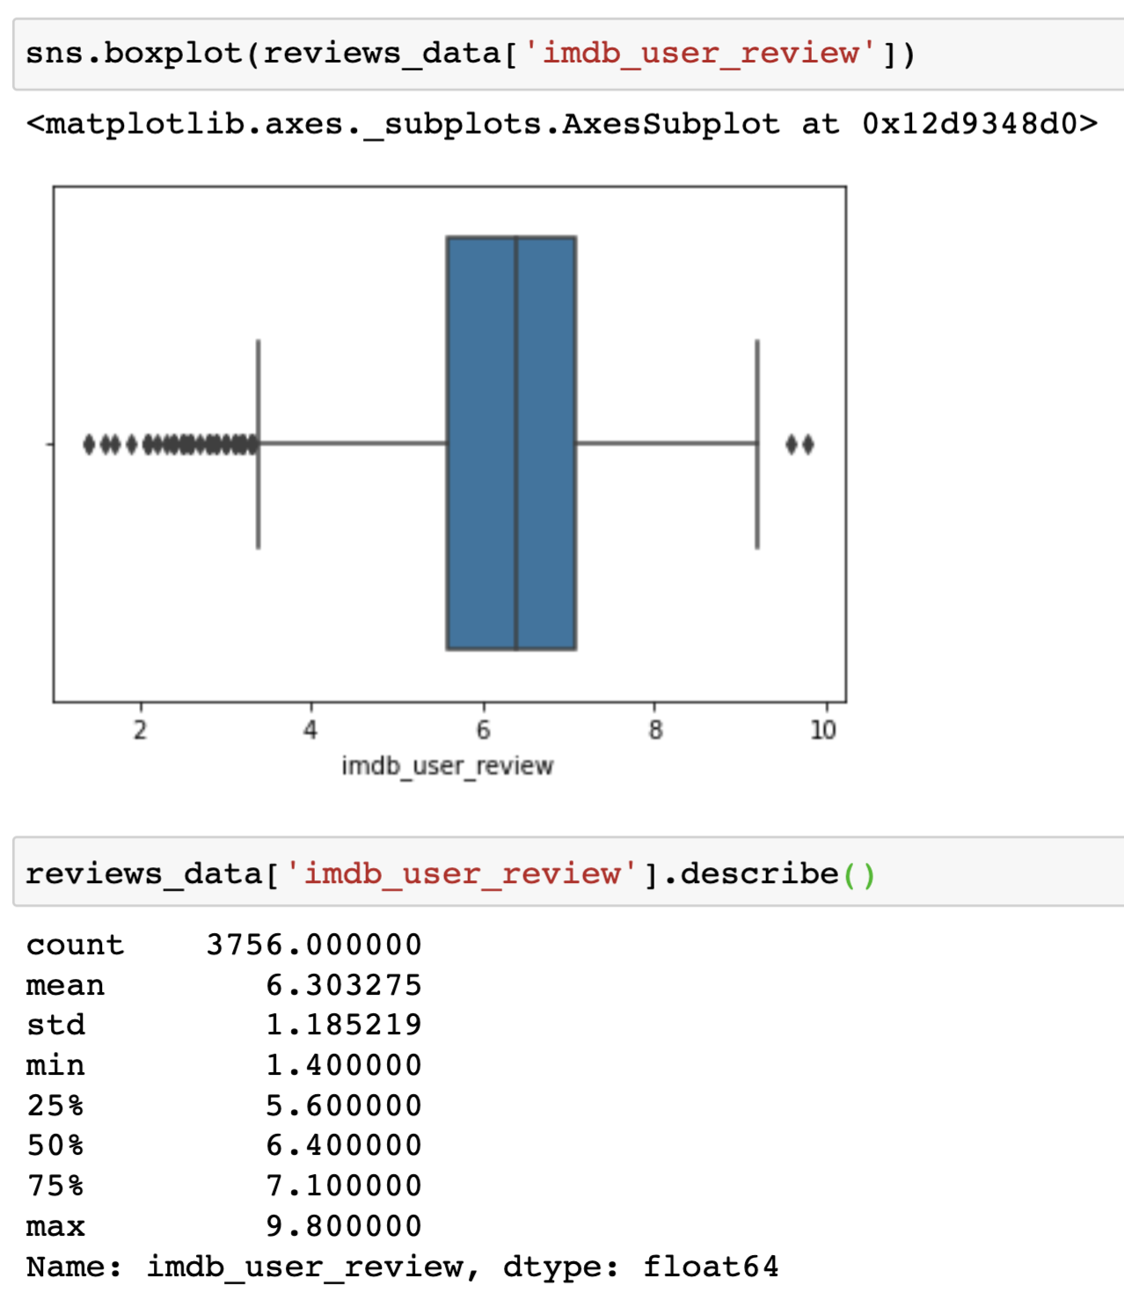
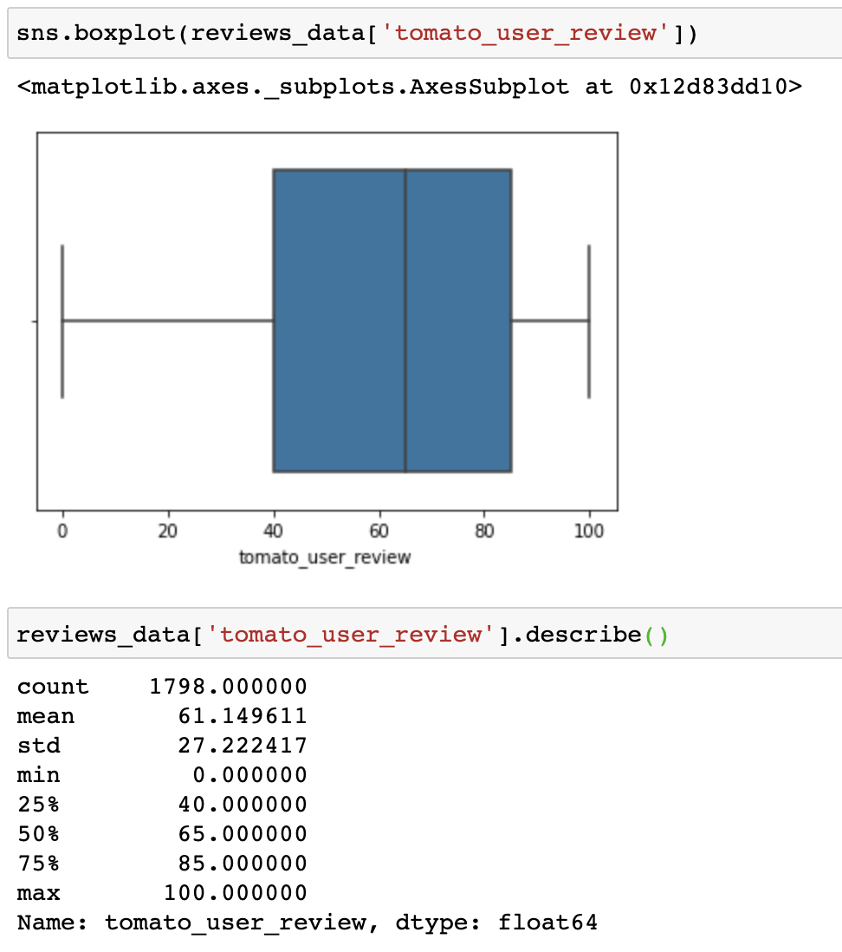
APPENDIX 1 - DATA OUTLIERS

Slide 35
APPENDIX 2 - DATABASE DESIGN
TYPE OF DATABASE | Relational database with a snowflake schema
TYPE OF APPLICATION | OLAP – analytical
NUMBER OF USERS | Multiple Users
DISTRIBUTED DATABASE | Needs to be distributed but not partitioned
DATABASE SECURITY | DBMS will allow only users with passwords with read/write ability

Slide 36
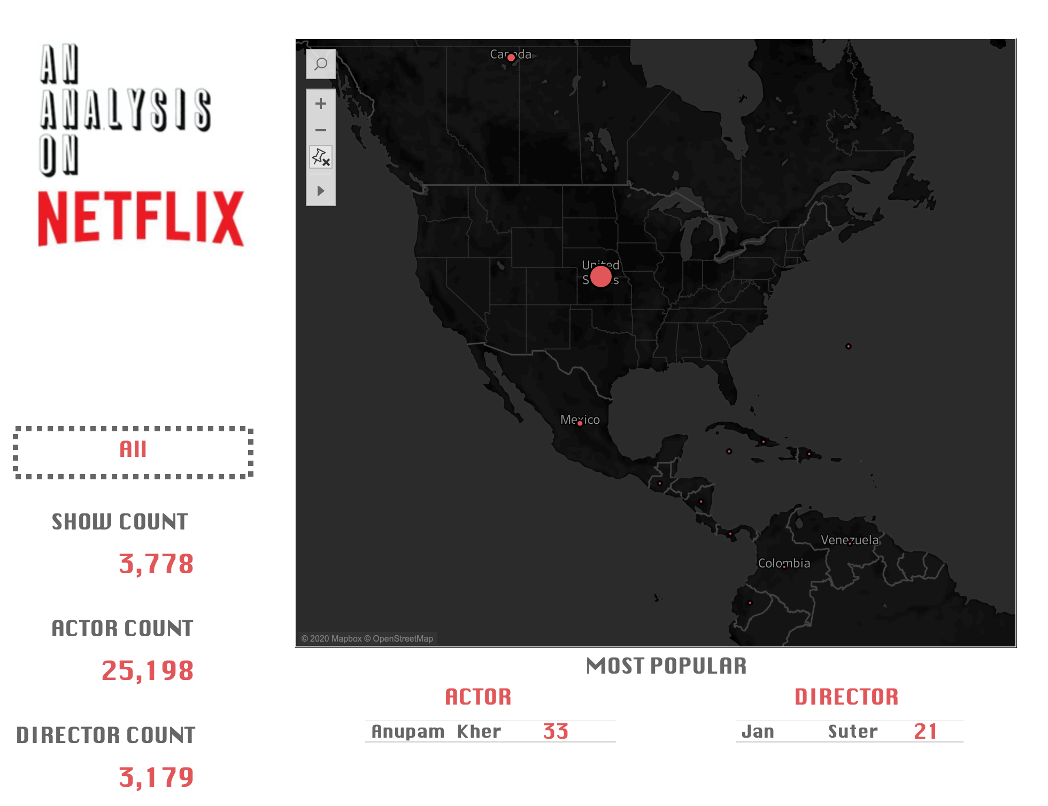
Tableau: Basic Overview
APPENDIX 3 – DASHBOARD 1

Slide 37
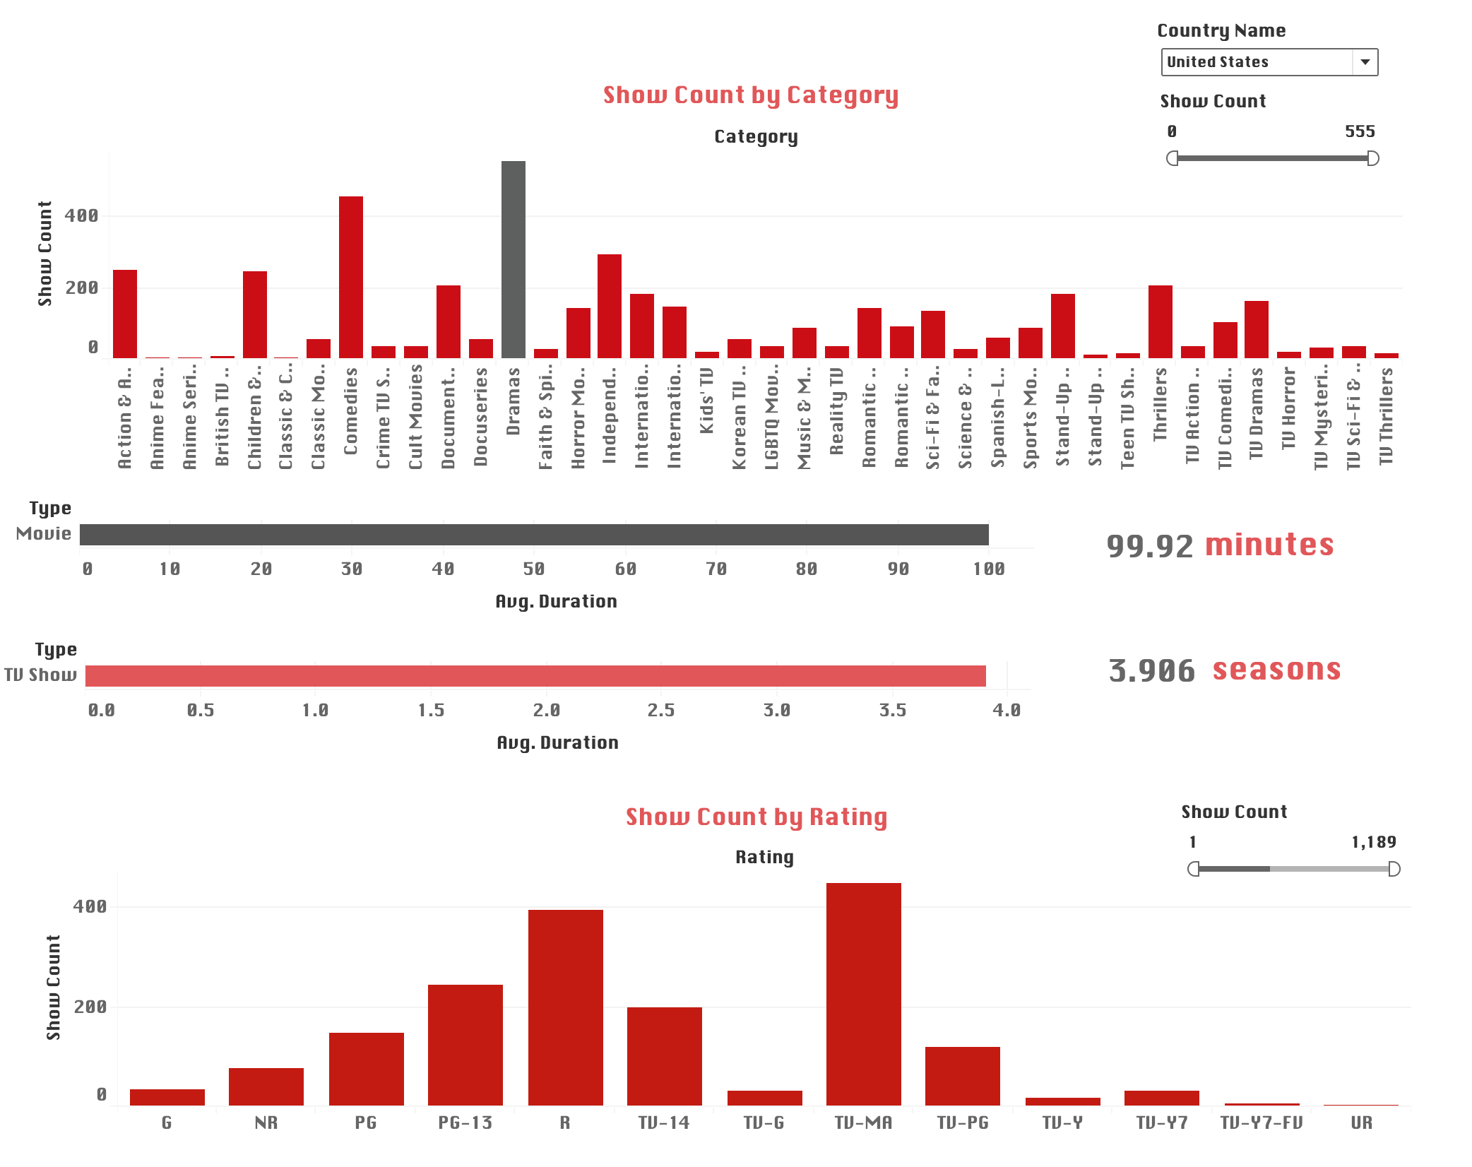
Tableau: Overall
APPENDIX 4 – DASHBOARD 2

Slide 38
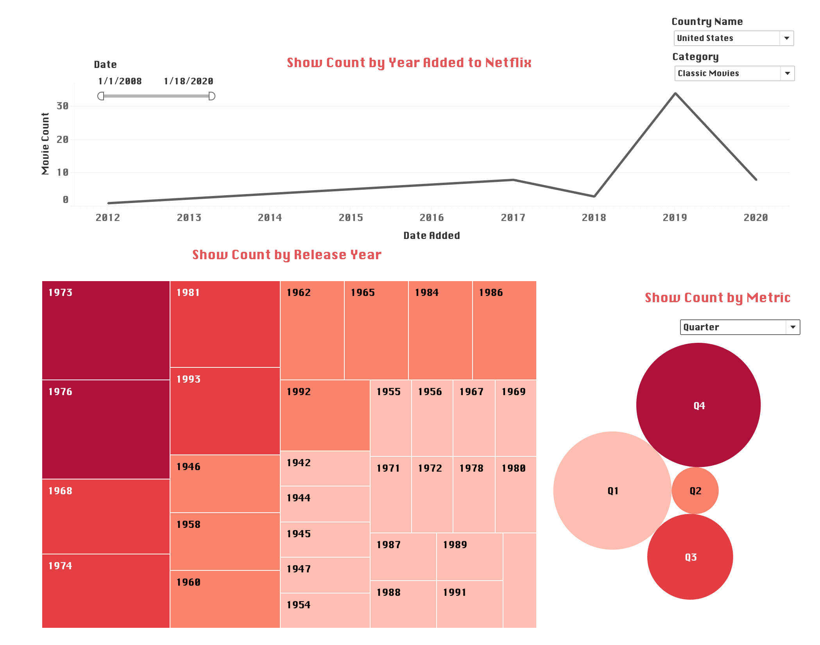
Tableau: Time Analysis
APPENDIX 5 – DASHBOARD 3

Slide 39
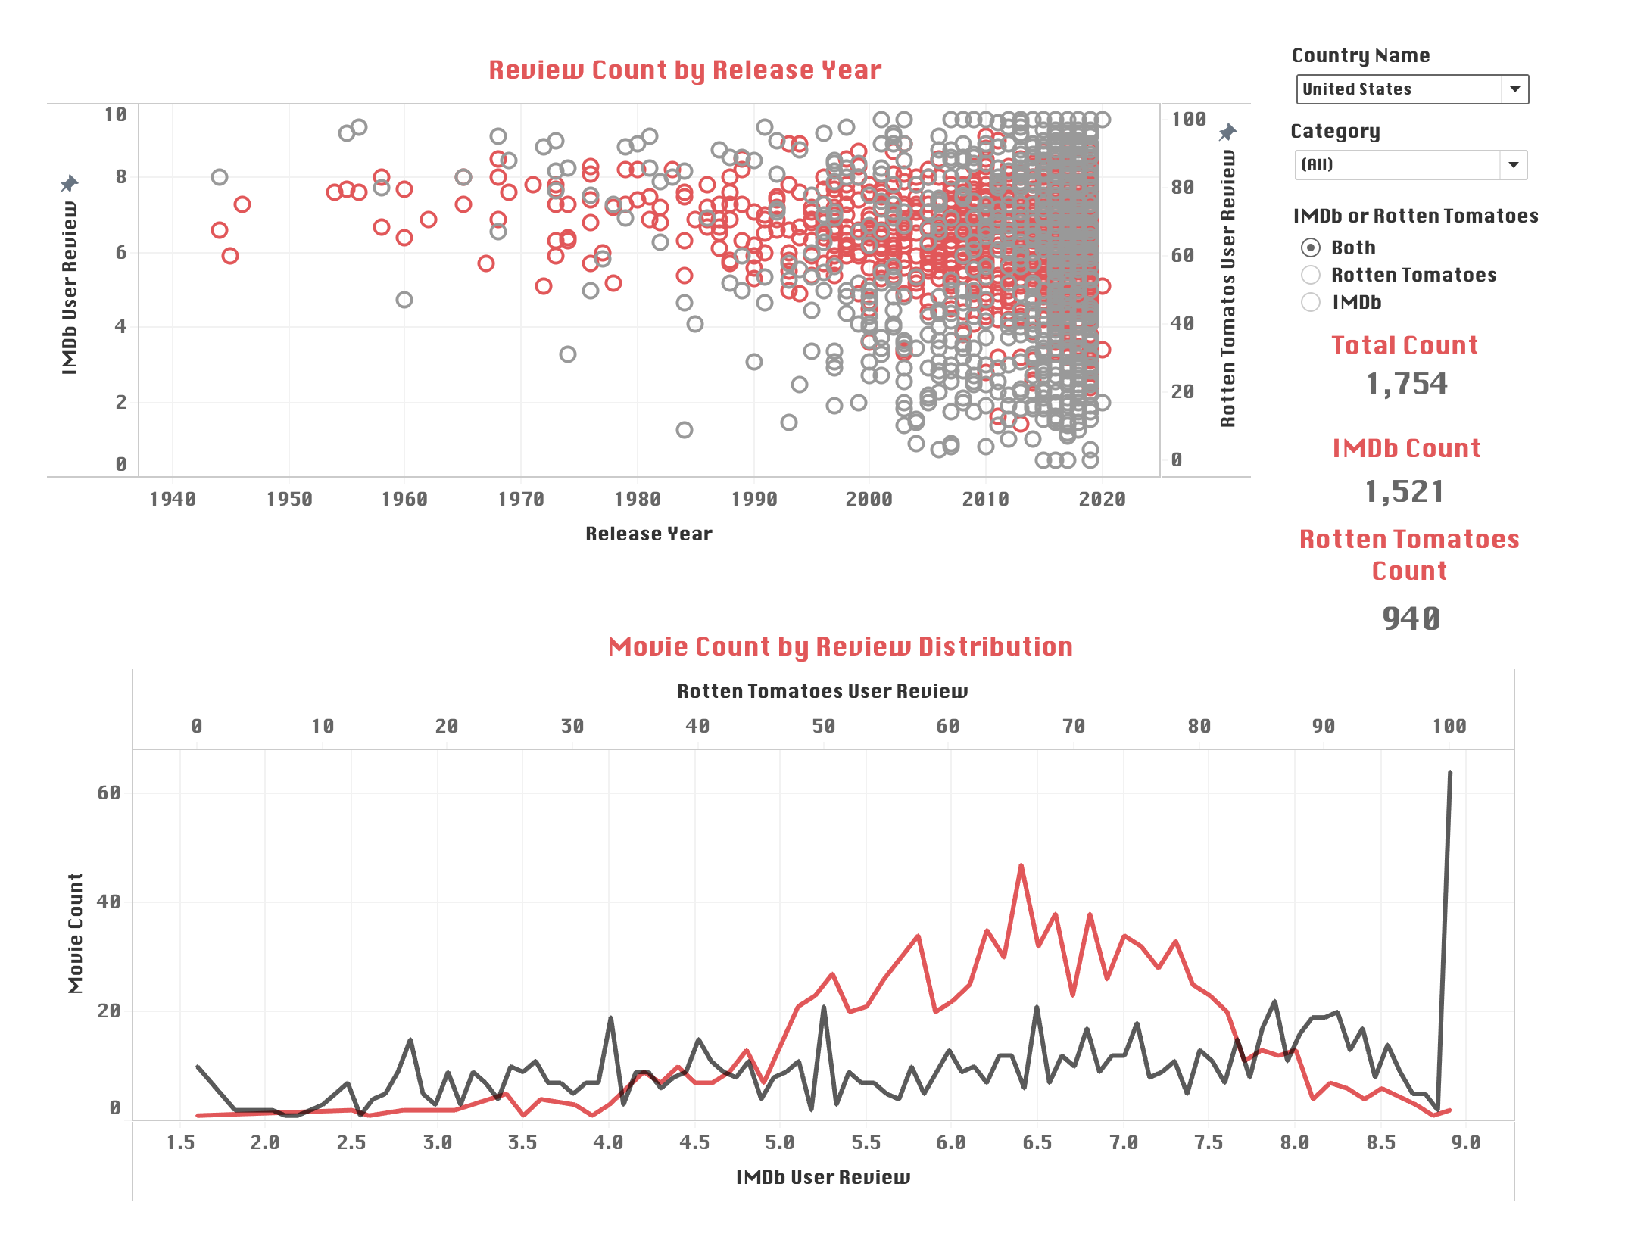
Tableau: Reviews
APPENDIX 6 – DASHBOARD 4

